Slide 1
London house price analysis
By Jaymin Mistry

Slide 2
Problem
Limited property availability and high prices in the capital of the UK.
Understanding of factors contributing to price will:
Enable buyers to identify best value property
Real estate websites to create recommender systems for users
Government to understand where resources can be best used to improve the availability of suitable housing.

Slide 3
Data sources
Majority of data accessed from https://data.gov.uk/ and https://data.london.gov.uk/
Price paid data – Land Registry http://landregistry.data.gov.uk/app/ppd
Gmaps distance matrix API

Slide 4
Approach
Collect data
Wrangle into a useable form
Conduct exploratory data analysis
Create linear Regression Model
Determine key factors and their significance

Slide 5
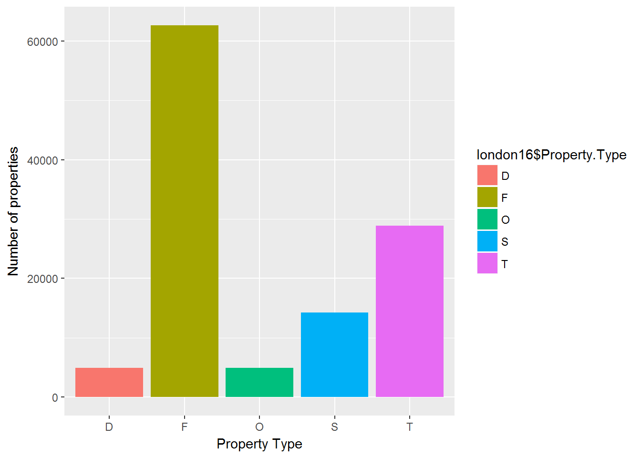
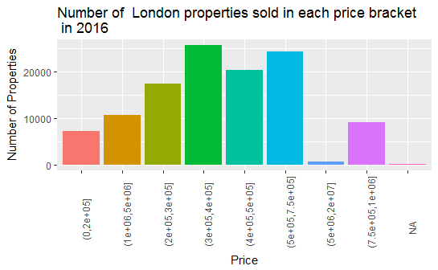
Initial data exploration

Slide 6
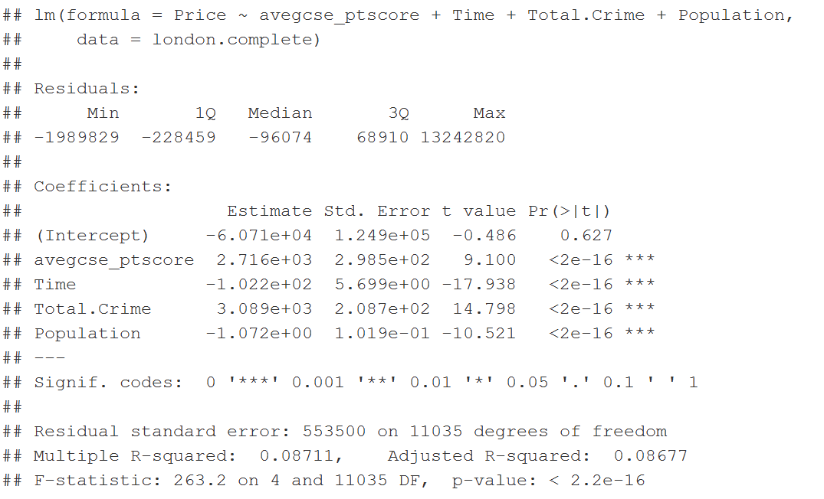
Model
prop.model.best <- lm(Price~ avegcse_ptscore + Time + Total.Crime + Population, london.complete)

Slide 7
outcomes
Home buyers: Properties in areas with higher crime rates but on the edges of Districts and therefore access to better schools in adjacent Districts may provide the opportunity to acquire an underpriced property
Property Websites: Inclusion of a crime rating and a graphical representation of this are features that are likely to assist buyers with selecting a property.
Government: Reducing crime levels may be the best way of improving the desirability of an area, alongside the quality of the schooling. Public transport is a significant factor but not as critical.

Slide 8
Further investigation
Examine data with greater granularity (down to LSOA level)
Further factors (green space, air pollution etc)
Examine historical trends
Compare price growth relative to changes (macro – government policy, micro – changes in local policy)
Plot results on an interactive R Shiny map.

